Slide 1

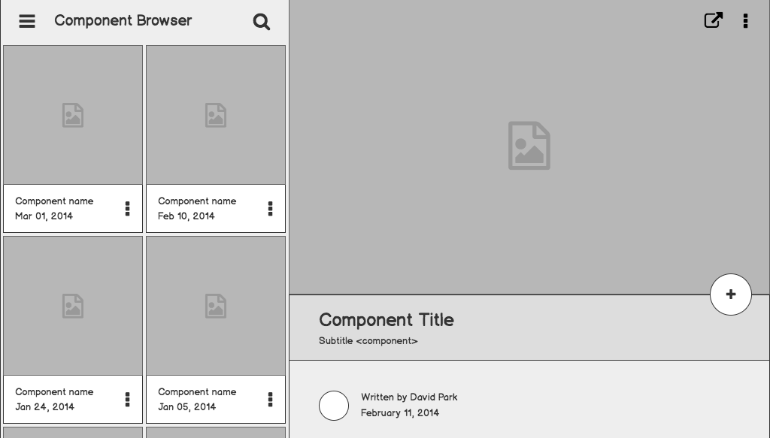

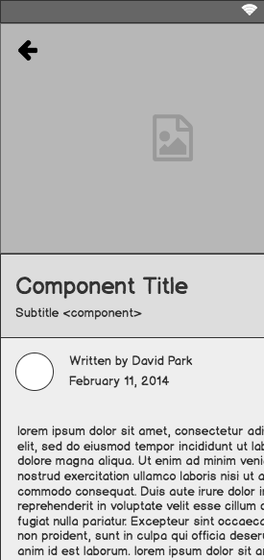

Network Device Monitoring & Building Wide Connectivity
Dustin Cogan, IT Director
Justin Hayward- Assistant Director
Maquoketa Community Schools- Iowa

Slide 2

Outline
Why Network Monitoring Is Essential?
Demonstration of existing network options
Demonstration of setup
Partner Vendor For This Product (Special for Brainstorm Only)
Questions

Slide 3
Why is Network Monitoring Essential?
Today’s Network Demands
SIS
VOIP
Security Cameras
Door Access Systems
Time Clocks
Digital Signage
PA Systems
State Testing
Internet
Fire Systems/ Alarm Systems
Others
Yesterday’s Demands
SIS
Internet
VS
The networking demands in today’s schools are far greater than they have ever been.
I do not see this slowing down any time soon, but instead increasing in the foreseeable future.

Slide 4
What tools are available to mitigate bandwidth constraints?
Closet Uplinks (100mb or 1gb) – 10g
Ethernet uplink teaming (aggregate 1 up to 8 1gb links) mfg specific
Firewall/AP Controls
Layer 7 application throttling, IP throttling, SSID throttling,
Many ways to adjust bandwidth prior to adjusting your main “pipe”
Upgrade your Internet Connection only to find you have the same issues
VS blindly

Slide 5
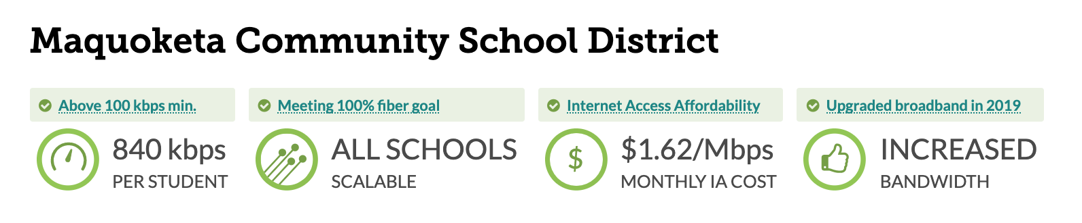
How Much Is Enough?
You will not hear me recommend a set amount of bandwidth….. PERIOD….. as there is no set answer, it is all based on usage and data.
You need to know the direction your district is moving to determine needs to meet USAC requirements.

Slide 6
Problem statement
How Do you Know Closet/Uplink/Downlink Bandwidth Utilization?
How do you know if you should erate for additional bandwidth?
How do you plan network connections beyond one year?
----------
Important Thought: Purchase enough bandwidth to sustain and expand programs while keeping budget sustainability in mind and the impact to the overall picture
----------

Slide 7
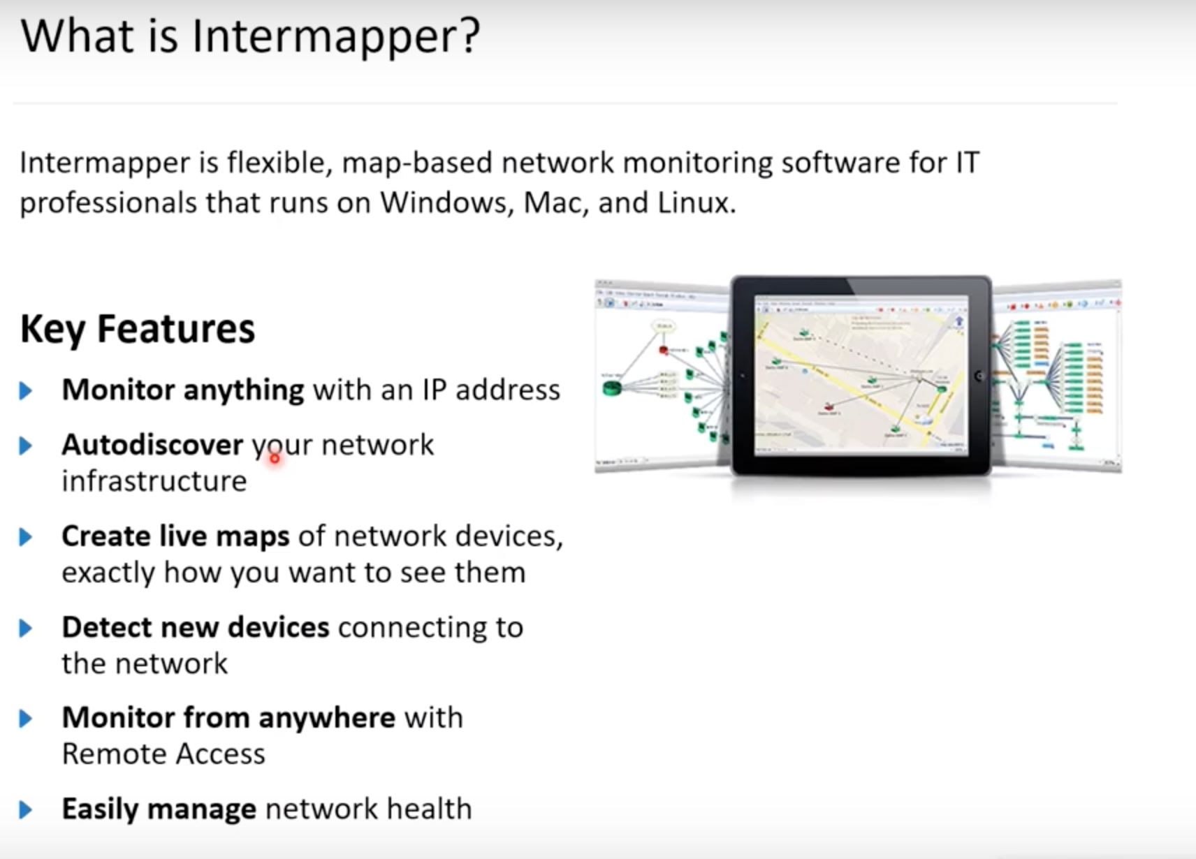
What is Intermapper?

Slide 8
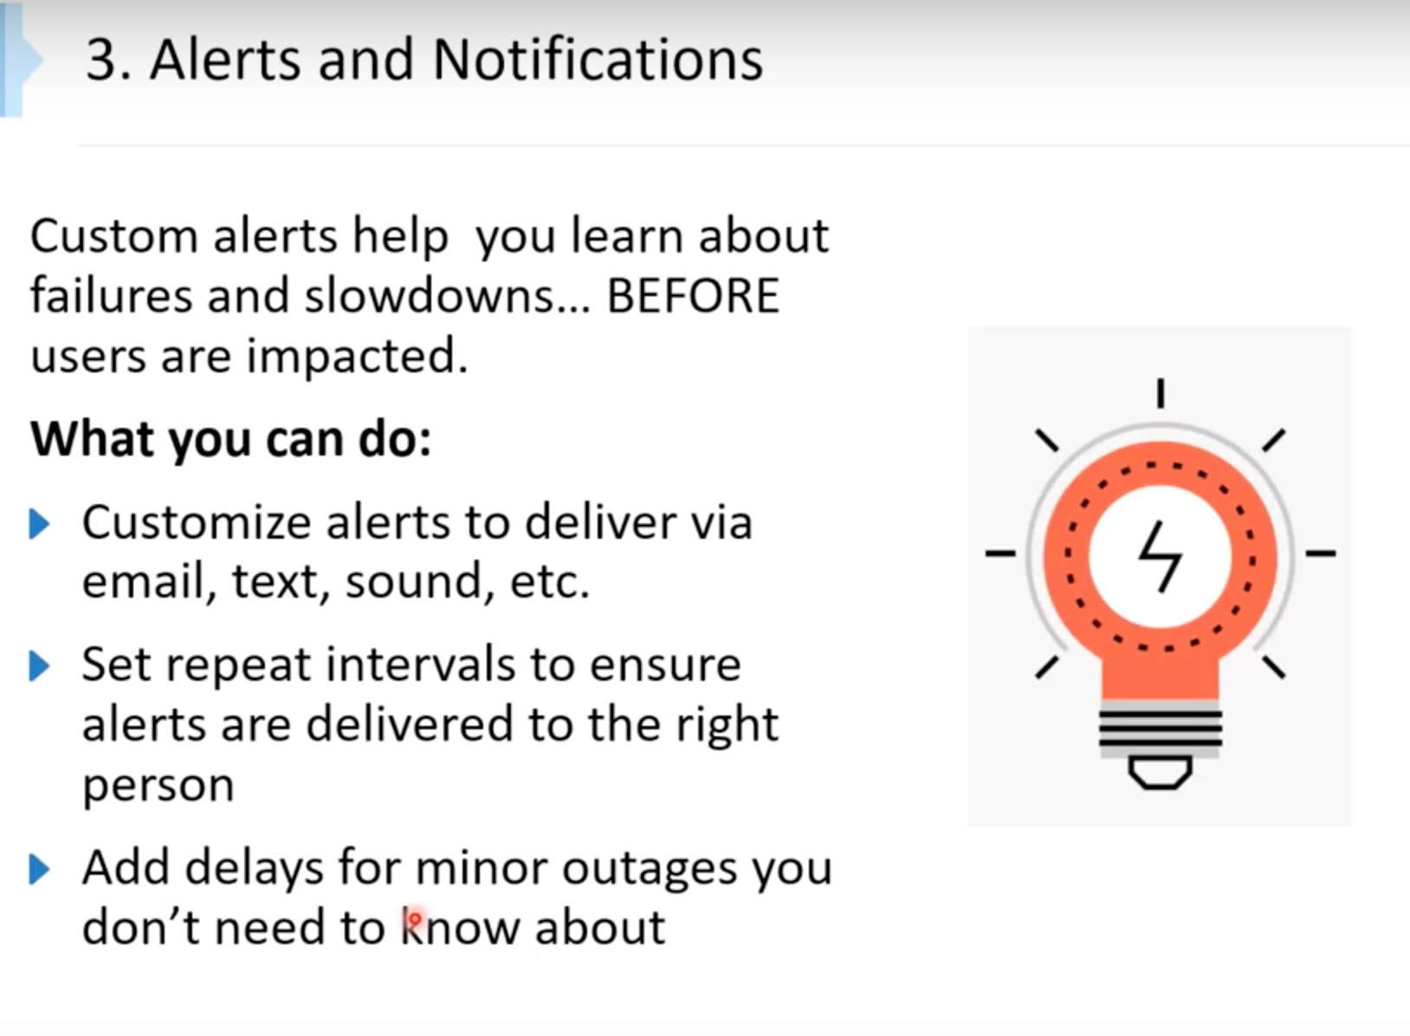
How am I
notified?

Slide 9
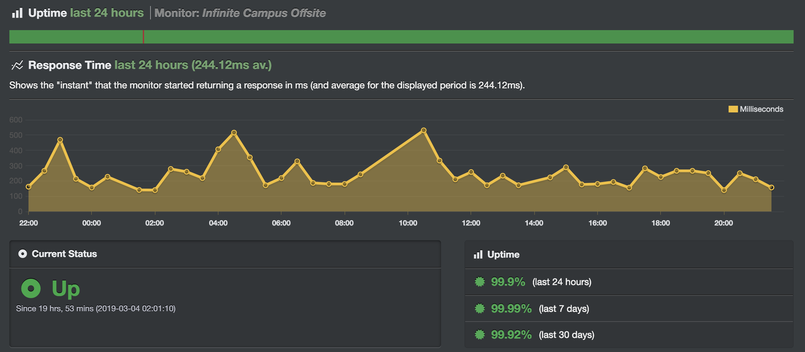
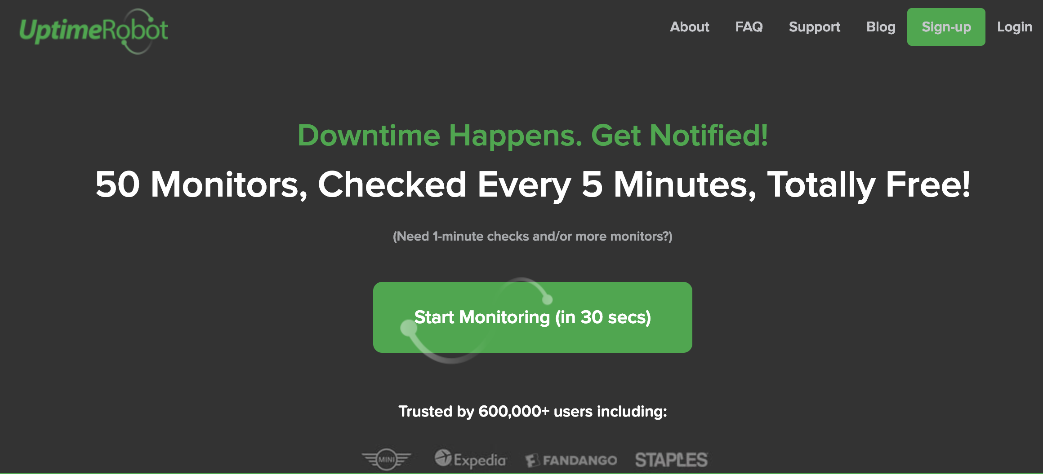
Monitoring is Necessary Also From Outside Your Network Looking In…...

Slide 10
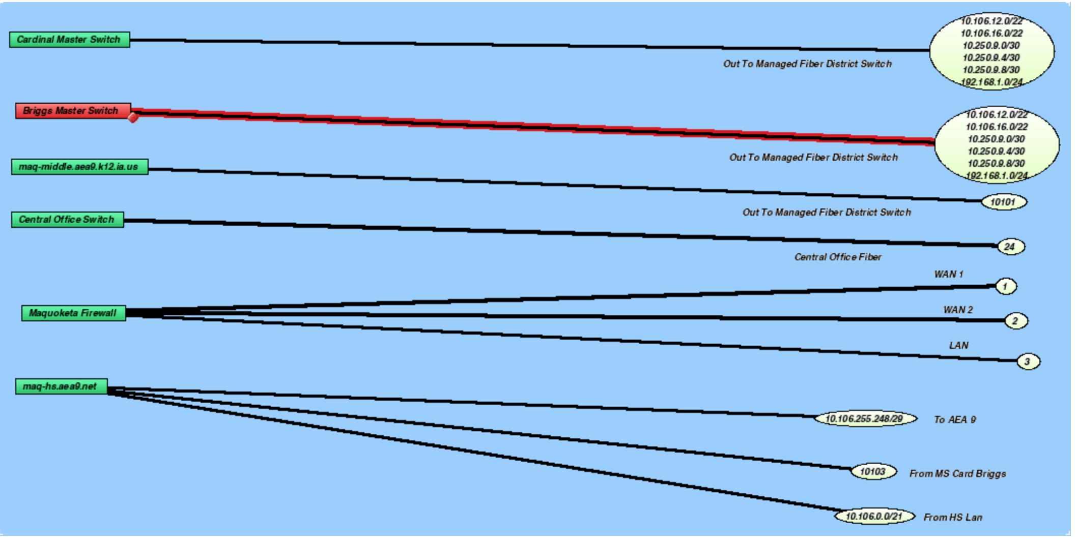

Slide 11
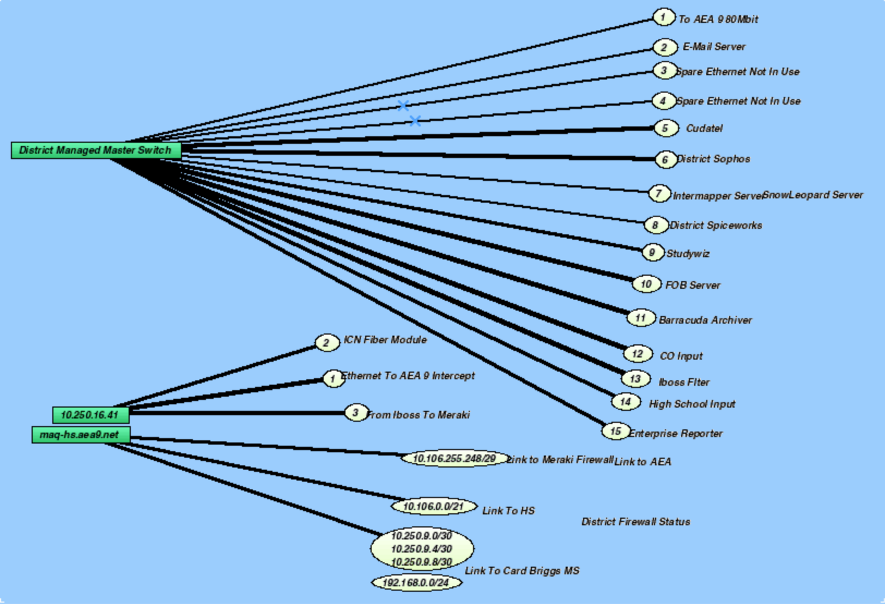

Slide 12
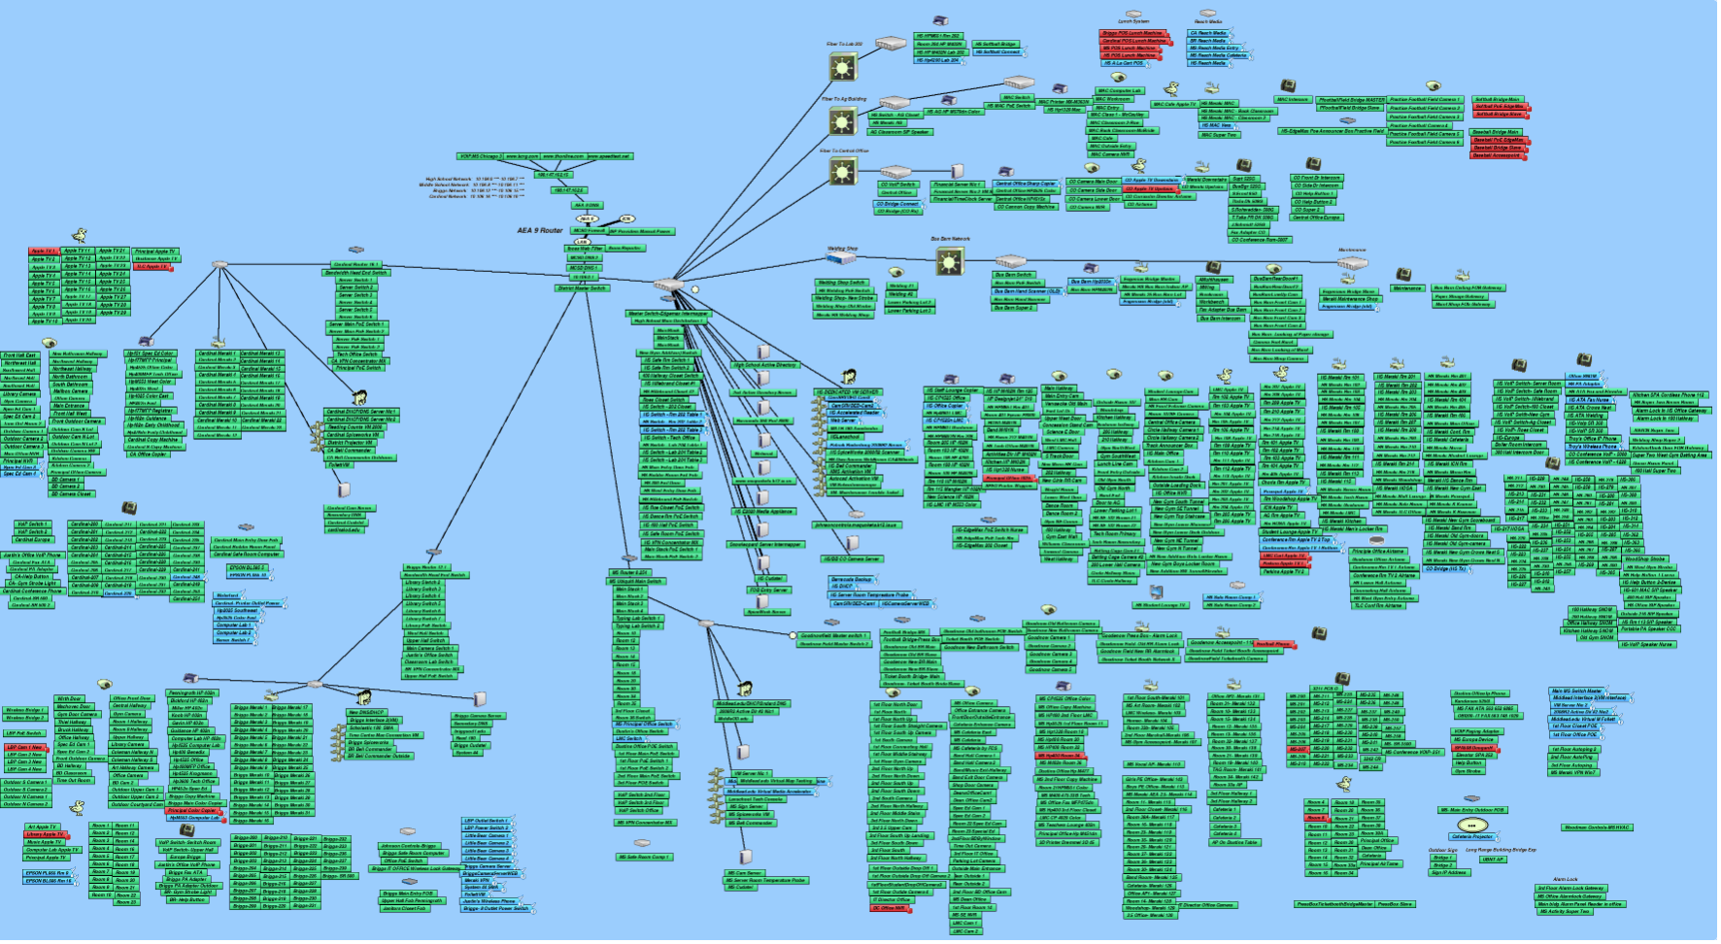

Slide 13

Preferred Vendor:
“Exclusive Pricing Brainstorm Special”
20-25% Off
SHI International
-Victoria Pelosi- Booth-
• 25 devices - $550 + $215 annual Support & Maintenance
• 50 devices - $1,075 + $215 annual Support & Maintenance
• 100 devices - $1,965 + 20% annual Support & Maintenance
• For larger device counts, please advise

Slide 14
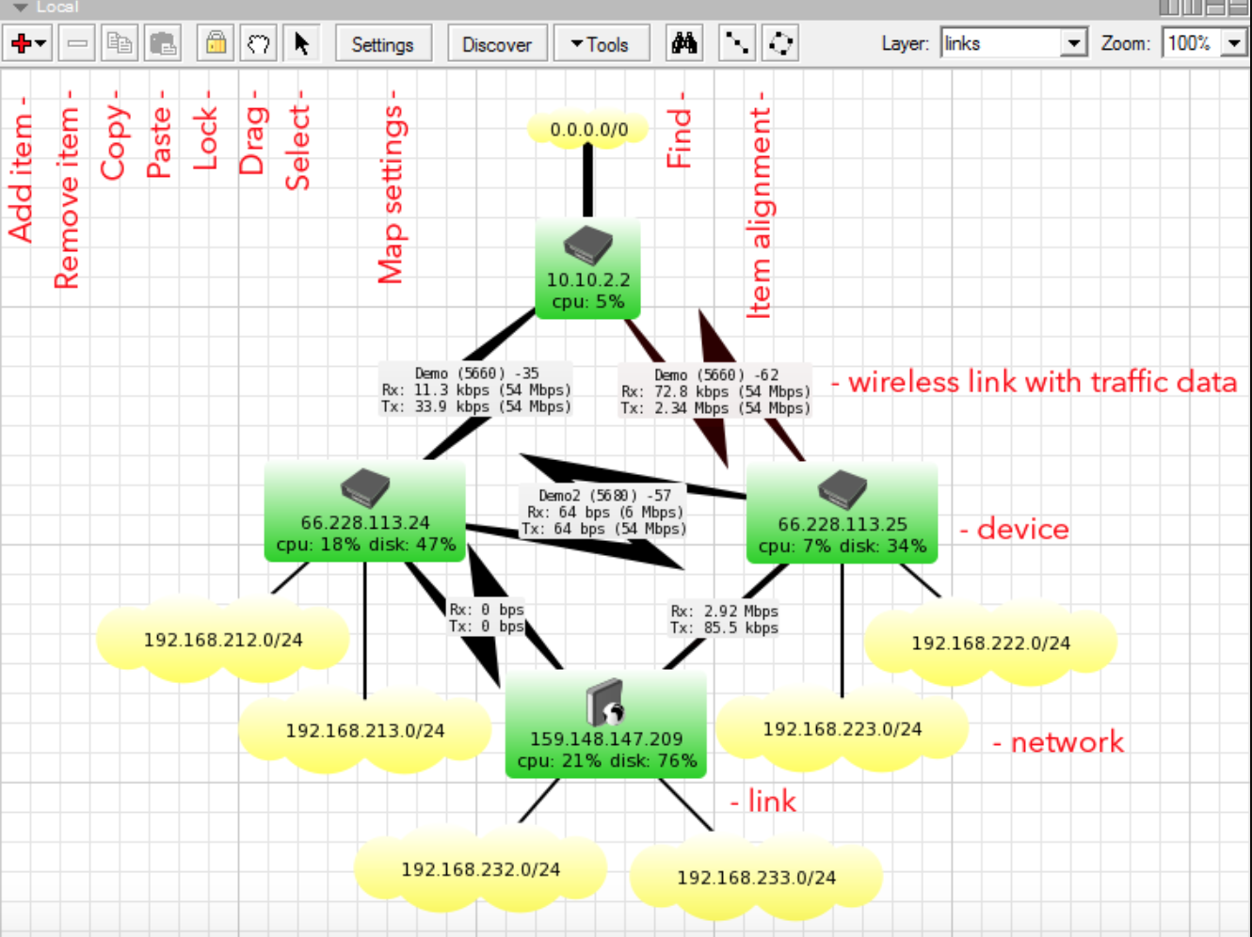
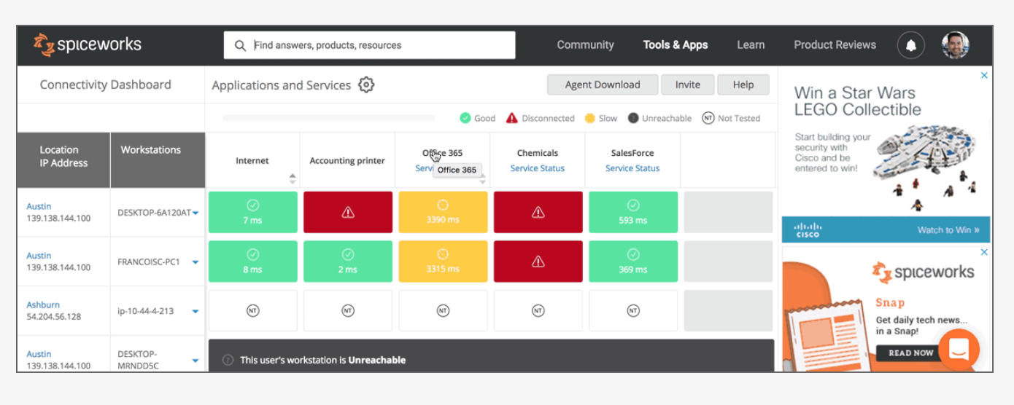
Other Options?
- The Dude
- Spiceworks (Monitoring and Connectivity)

Slide 15
Questions?

